Slide 1

Welcome
(Akwaaba)
Congratulations

Slide 2

Administrivia
Course Code: INF101
Course Title: INTRODUCTION TO COMPUTING
Credit: 3 hours
Lecturer: Kofi Akotoye
(pref. Kofi)
Office Hours: Tuesday/09:00 – 11:00
Website: INF101 portal on UCC LMS
Assessments: 2 Quizzes & Exam
        Offline/Online ?
        Quiz – Fast food
        Exam – Full course dinner
Announcements/Updates: Course website
Mobile identity:

Slide 3
INTRODUCTION

Slide 4
Computer?
“An electronic device, operating under the control of instructions stored in its own memory, that can accept data (input), process the data according to specified rules, produce information (output), and store the information for future use.”

Slide 5
Computer
Makeup?
Component (Hardware)
Material
  Electrical
  Electronic
  Mechanical
Function
  Input (Receive)
  Process (Manipulate/Evaluate)
  Output (Produce/Supply)
  Storage (Retain)
  Communicate (Transfer)

Slide 6
Computer
Instructions/Commands (Software/Program/Apps)
Data (Raw/Unprocessed)
  Text
  Number
  Image
  Sound
  Video
Information (Processed/Facts/Result)
  Text
  Number
  Image
  Sound
  Video
  Packet

Slide 7
How to command the Computer
User interface
  Command Line Interface (CLI)
    Text driven
  Graphical User Interface (GUI) (or WIMP)
    Menu driven
    Touchscreen
    Voice interface
Programming language
  1st Generation – Machine language (1GL)
    Uses bits (0/1)
  2nd Generation – Assembly language (2GL)
    Uses mnemonics (mov, add, mul, etc)
  3rd Generation – High level language (3GL)
    Natural language (let, if, break, import, return, etc)
    Programmer friendly
    Machine Independent
    Ex: C, C++, C#, Java, BASIC, Pascal, Fortran, ALGOL, COBOL
Notes:
WIMP – Windows, Icons, Menus & Pointers

Slide 8
How to command the Computer
Programming lang. contd.
4th Generation – Very high-level language (4GL)
  specialized toward very specific programming domains.
    support for database management
    report generation
    mathematical optimization
    GUI development
    web development.
    Ex: SQL, Unix Shell, Oracle Reports, R
5th Generation (5GL)
    Instructions are designed as constraints (conditions) rather than algorithms (steps)
    Also known as logic-based languages or declarative languages.
    Ex: OPS5, Mercury

Slide 9
Characteristics of Computers
Automatic
  Mostly require no human involvement during processing of task
Speed
  Guarantee fast processing
    Microseconds (10-6)
    Nanoseconds (10-9)
    Picoseconds (10-12)
Accurate
  Consistently high
  Design dependent
  Garbage In Garbage Out (GIGO)
    Bad input
    Bad programming
Diligent
  Guarantee continuity of work
  Heat, dust, hacking

Slide 10
Characteristics of Computers (contd)
Versatile
  Capable of performing potentially any task
  Task can be reduced to a finite series of logical steps
Storage
  Capable of keeping large volume of data/information
  Capable of performing efficient house keeping
Dumb and Zombie!
  Very excellent at carrying out instructions
Inanimate
  But please treat them with respect

Slide 11
Computer History
Generation -> Categorized according to Hardware and Software
First (1940 – 1956)
  Processor: vacuum tube
Second (1956 – 1963)
  Processor: transistor
Third (1964 – 1971)
  Processor: integrated circuit (IC)
Fourth (1971 – 1980)
  Processor: VLSI microprocessor
Fifth (> 1980)
  Processor: ULSI microprocessor

Slide 12
A little back in time
1642
Blaise Pascal
Mechanical Adding Machine
1671
Baron Gottfried Wilhelm von Leibniz
Calculator for multiplication
1822
1880
Charles Babbage
(father of modern digital computers)
Difference Engine
An analytical engine capable of performing arithmetic functions
His efforts established a number of principles that are fundamental to the design of any digital computer
Herman Hollerith
Punch Card
Input media that existed till late 1970s

Slide 13
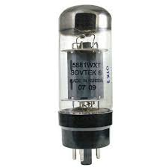
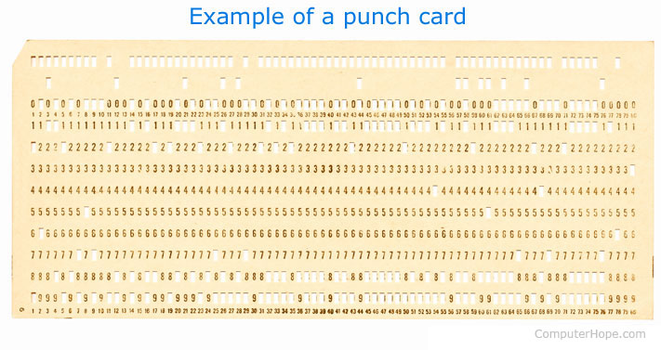
First Generation
(1940 – 1956)
Generation | Key Hardware Technologies | Key Software Technologies | Key Characteristics | Examples of Systems
First | Vacuum tubes Electromagnetic relay memory Punched cards | Machine & Assembly languages Stored program concept Mostly scientific applications | Bulky size Highly unreliable Limited commercial use and costly Difficult to use | ENIAC EDVAC EDSAC UNIVAC I IBM 701

Slide 14
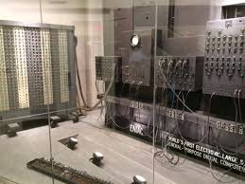
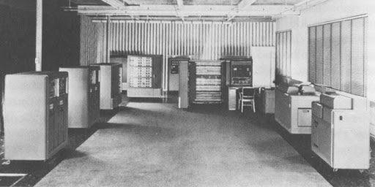
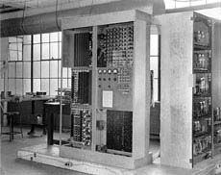
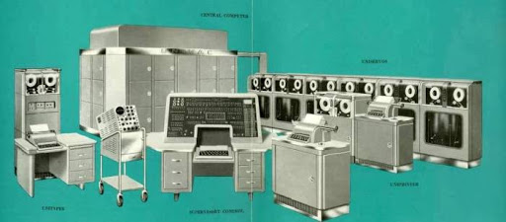
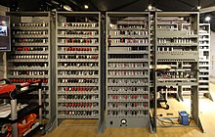
Digital Trailblazers

Slide 15
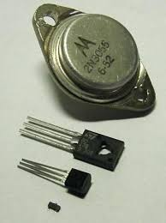
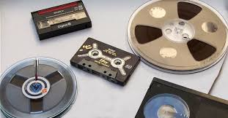
Second Generation
(1956 – 1963)
Generation | Key Hardware Technologies | Key Software Technologies | Key Characteristics | Examples of Systems
Second | Transistors Magnetic cores memory Magnetic tapes Disks for secondary storage | Batch operating system High-level programming languages Scientific and commercial applications | Faster, relatively smaller, more reliable and easier to program Costly and commercially unattractive | UNIVAC II IBM 7030 CDC 1604 Honeywell 400

Slide 16
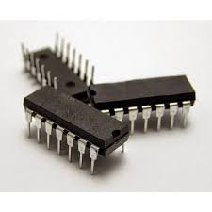
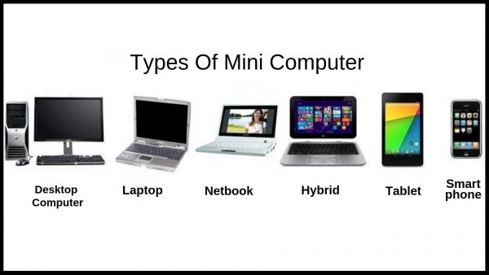
Third Generation
(1964 – 1971)
Generation | Key Hardware Technologies | Key Software Technologies | Key Characteristics | Examples of Systems
Third | ICs with SSI and MSI technologies Larger magnetic core memory Larger capacity disk and magnetic tape secondary storage Minicomputers | Timesharing operating system Standardization of high-level programming languages Unbundling of software from hardware | Faster, smaller, more reliable, easier and cheaper to produce Commercially, easier to use and easier to upgrade Scientific, commercial and interactive online applications | IBM 360/370 PDP-8 PDP-11 CDC 6600

Slide 17
Fourth Generation
(1971 – 1980)
Generation | Key Hardware Technologies | Key Software Technologies | Key Characteristics | Examples of Systems
Fourth | ICs with VLSI technology Microprocessor, semiconductor memory Large capacity hard disks as in-built secondary storage Magnetic tapes and floppy disks as portable storage media PC Supercomputers based on parallel vector processing and symmetric multiprocessing technologies Spread of highspeed computer networks | Operating systems for PCs with GUI and multiple windows on a single terminal session Multiprocessing OS with concurrent programming languages UNIX OS with C programming language Object-oriented design and programming PC, network-based and supercomputer applications | Small, affordable, reliable and easy to use PCs More powerful and reliable mainframe systems and supercomputers Totally general-purpose machines Easier to produce commercially Easier to upgrade Rapid software development possible | IBM PC and clones Apple II TRS-80 VAX-9000 CRAY-1 CRAY-2 CRAY-X/MP

Slide 18
Fifth Generation
(> 1980)
Generation | Key Hardware Technologies | Key Software Technologies | Key Characteristics | Examples of Systems
Fifth | ICs with ULSI technology Larger capacity main memory Hard disks with RAID support Optical disks as portable read-only storage media Notebooks, powerful desktop PCs and workstations Power servers and supercomputers Internet Cluster computing | Micro-kernel based, multithreading, distributed OS Parallel programming libraries like MPI & PVM Java World Wide Web Multimedia, internet applications More complex supercomputing applications | Portable computers Powerful, cheaper, reliable and easier to use desktop machines Powerful supercomputers High uptime due to hot-pluggable components (PnP) Totally general-purpose machines Easier to produce commercially, easier to upgrade Rapid software development | IBM notebooks IBM SP/2 SUN Workstations SGI Origin 2000 PARAM 10000

Slide 19
Triviamania
Computer Engineering
  Design and develop computers (component & function)
  Systems designer, network designer
Computer Science
  Define and formulate tractable computing solution
  Design and implement algorithms
  System engineer, network engineer, software engineer
Information Technology
  Integrates computers and algorithms into cutting edge solutions
  System administrator, network administrator, database administrator, system analyst
Informatics
  Information transformation
  Data storage and retrieval
  Library science
Information Systems
  Study task, people and computers to deliver organisational goals

Slide 20
Acknowledgement
Open Door – istockphoto
Office 365 online gallery
Wikipedia
Computer Hope

